Slide 1
Survey System
By: Atullya Maharjan

Slide 2
Survey System
A survey system is a tool used to gather information and opinions from participants on various topics.
Participants respond to a series of questions, and their answers are collected and analyzed to gain insights or make decisions based on the survey's objectives. The system is straightforward to use and doesn't require any special equipment.

Slide 3
Objectives
To develop an interactive survey system in Java that efficiently manages survey data
To create a user-friendly interface for interaction between users and the survey system.
To use database table and relationship for efficient handling and organization of survey question and responses.

Slide 4
Key Feature of the Survey System are as follows:
Dynamic Survey Creation: The survey system allows users to create customized surveys on various topics.
2. Data Management and Analysis: The system employs relational database techniques to efficiently manage, store, and analyze survey responses.
3. Feedback: After participating in surveys, the system provides users with immediate results, enhancing the interactive experience.

Slide 5
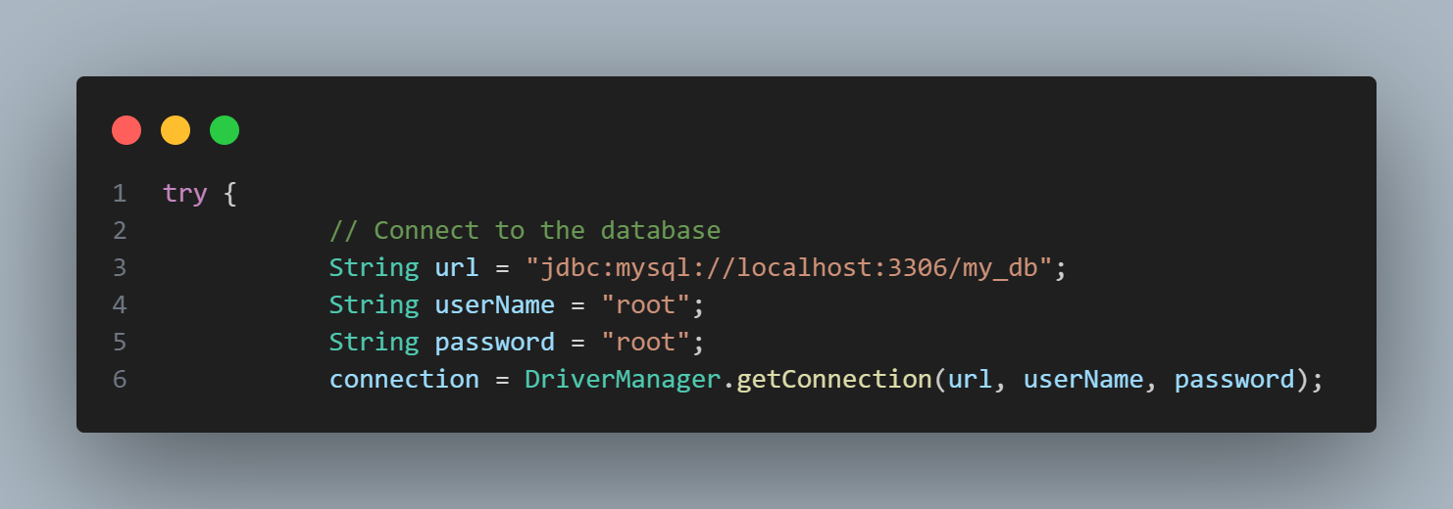
The provided code snippet establishes a connection to a MySQL database using Java's JDBC API. This connection allows the Java application to execute SQL queries and interact with the database.

Slide 6
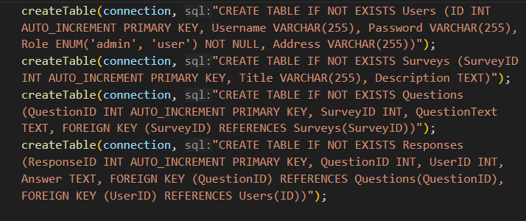
This method is responsible for creating tables in the database if they do not exist

Slide 7
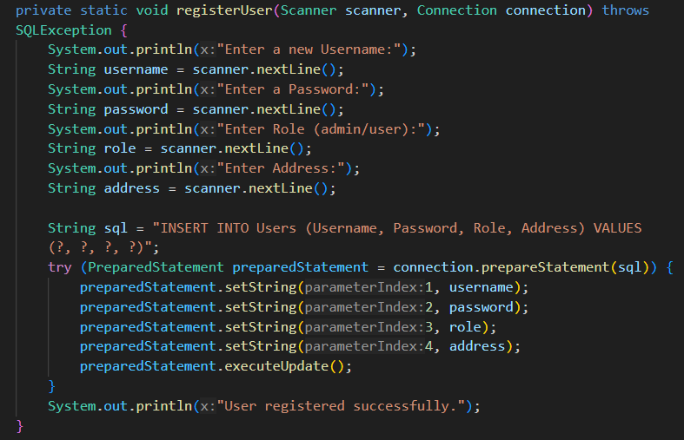
This function handles the registration of new users in the system. It collects user input for username, password, role, and address, then inserts these details into the Users table in the database.

Slide 8
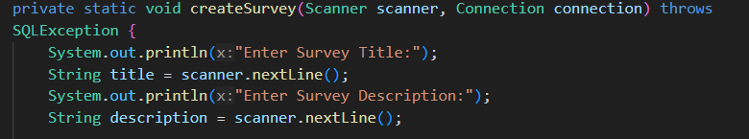
This function manages the creation of new surveys.

Slide 9
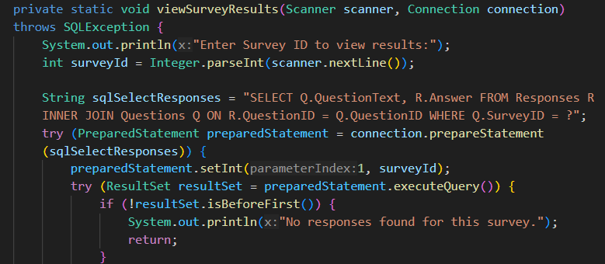
This method is used to view the results of a specific survey.

